Slide 1
Big Mountain resort
Ticket pricing solutions

Slide 2
OBJECTives
To offset the operating costs of the newly installed chairlift, which amount to $1.54 million this season and keep the business profitable.
To maximize profits by either shutting down some of the less used resort facilities to save on expenses or to support higher ticket prices

Slide 3
Strategies
Evaluate data from more than 300 U.S. ski resorts within the same market segments
Analyze geographical, operational and facility details of other resorts to find possible solutions to increase ticket pricing support for Big Mountain.

Slide 4
Methods used for price prediction
Using average ticket price of all resorts: the prediction might be off by as much as $19.
Using a linear regression model, the prediction error range was reduced to around $10.
Using a random forest regressor, the range was further reduced to around $9
Features that highly correlates with ticket price: Number of fast quads, runs, vertical drop, and area covered by snow making equipment

Slide 5
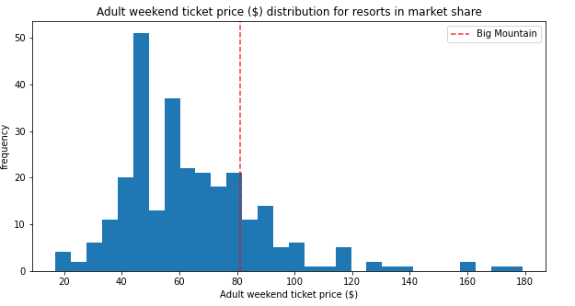
Modeling results
Big Mountain current price of $81 ranks in the upper end among the resorts.
Using forest regressor model: price can be increased to as high as $95.37

Slide 6
Solutions
Close up to 5 least used runs
Decrease support for ticket price by as much as $0.70
Revenue projected to drop by around $1.3 million
Increase vertical drop by 150 ft and install an additional lift
Increase support for ticket price increase by $1.99
Revenue projected to rise by $3.47 million
→ Profitable when factored in sum of operational cost of new lift ($1.54 million) and projected revenue drop when closing up to 5 runs (maximum $1.3 million)

Slide 7
Conclusion and future actions
Big Mountain can raise their price up to $95.37 by increasing vertical drop by 150 ft, installing a new chairlift and closing up to 5 least used runs.
Include other operation expenses (increase vertical drop, snowmaking area, add or close down any runs) for better price analysis
Create and maintain a website to help the company explore projected price support if any combinations of pricing solutions are implemented

